Slide 1
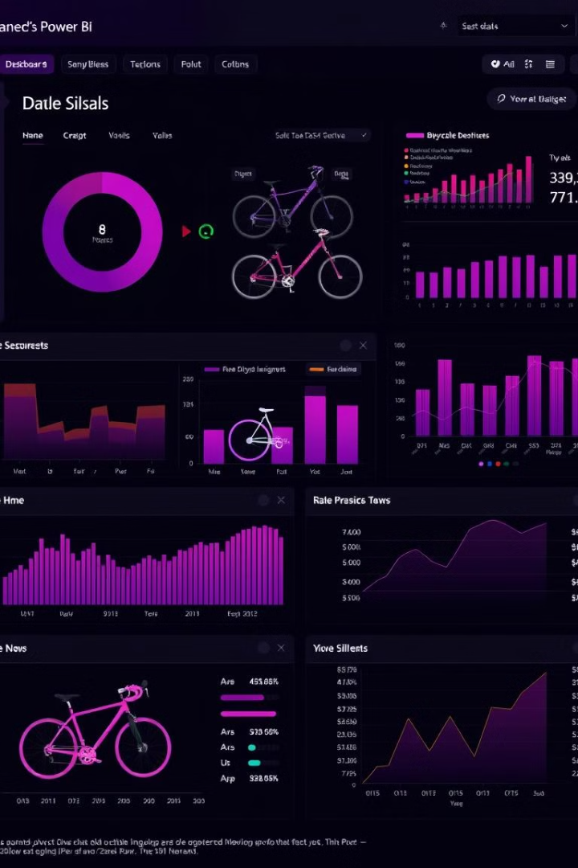
Power BI Dashboard for Bicycle Sales Analysis
Analyzing bicycle sales trends with Power BI

Slide 2
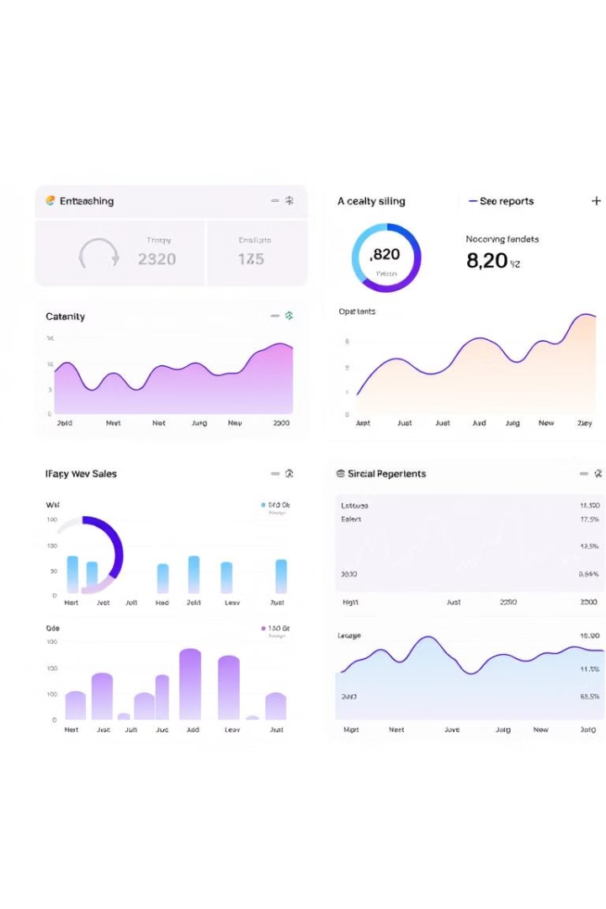
Project Problem
Lack of Insight
Inefficient Reporting
Limited understanding of sales patterns and trends
Manual data analysis and reporting, time-consuming

Slide 3

Solution: Power BI Dashboard
1
Interactive Data Exploration
2
Visualizations for Insights
3
Automated Reporting
Generate real-time reports for informed decision-making
Drill-down into sales data by category, country, and subcategory
Line charts, pie charts, treemaps, and geographical maps

Slide 4
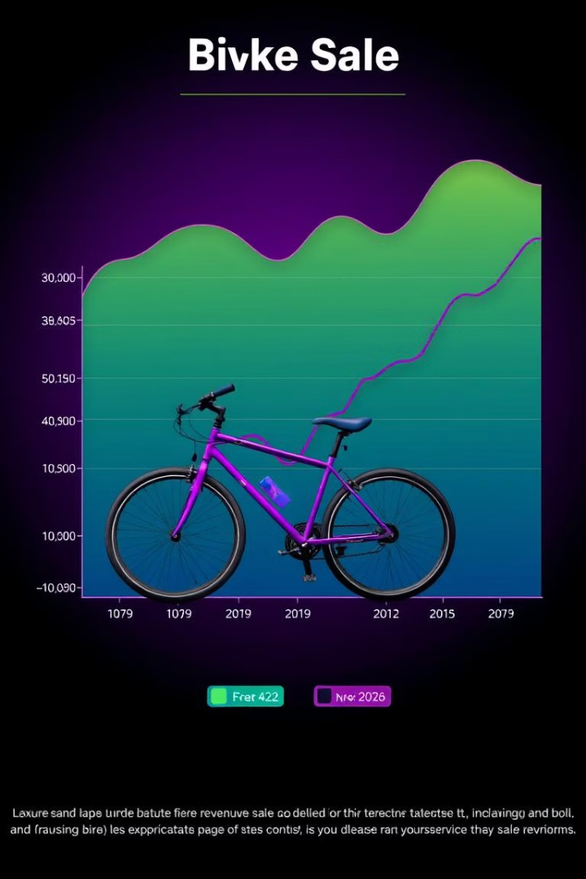
Project Analysis: Sales Trends
Identify top-performing subcategories for strategic focus
Analyze overall sales performance across different product categories

Slide 5

Geographic Analysis
Revenue by Country
Sales Performance by Region
Gain insight into market share and growth potential
Identify regional trends and optimize sales strategies

Slide 6
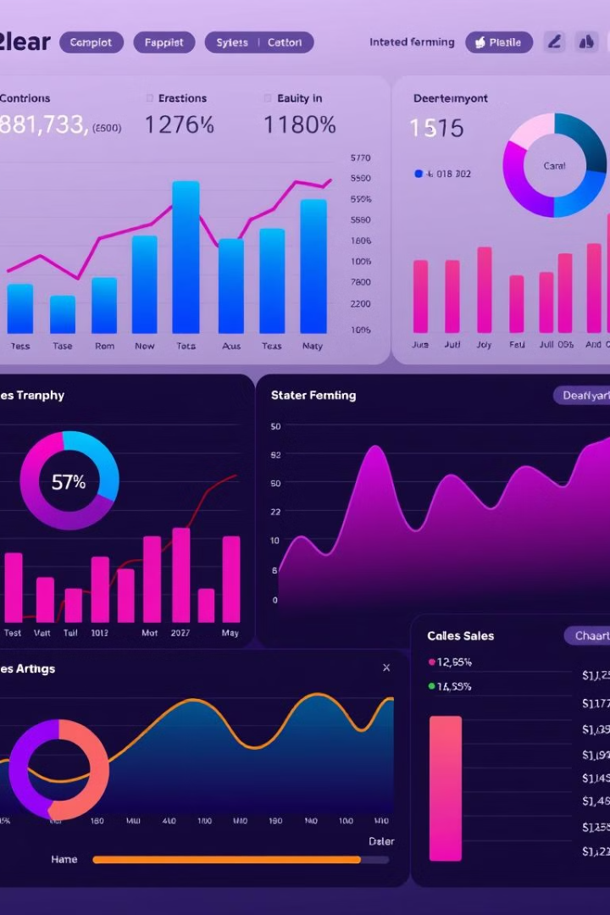
Detailed Subcategory Breakdown
The dashboard provides a granular view of sales performance for each subcategory within each product category.
This detailed analysis empowers users to identify specific areas for improvement, such as optimizing pricing, inventory management, or marketing strategies.

Slide 7
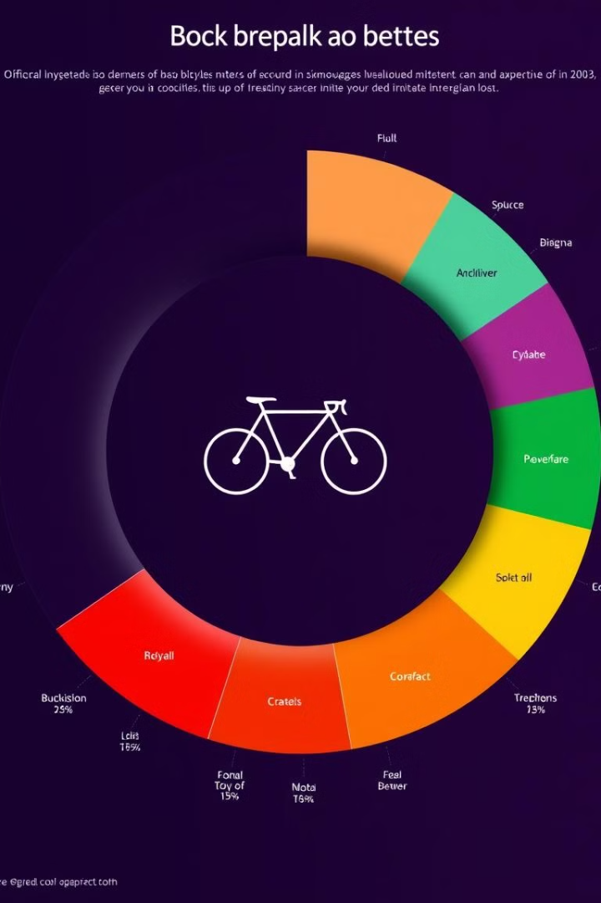
Detailed Subcategory Breakdown
Donut Chart for Visual Clarity
Enhanced Decision-Making
Represent revenue proportions across subcategories
Inform inventory management, marketing campaigns, and product development

Slide 8

Report and Conclusion
1
Summary of Findings
2
Data-Driven Recommendations
3
Conclusion
Concise overview of key sales trends and insights
Highlight the impact of Power BI dashboard on sales analysis
Actionable recommendations for sales optimization and growth

Slide 9



Next Steps: Continuous Improvement
Expand Data Sources
1
Incorporate additional relevant data for comprehensive analysis
Enhance Visualizations
2
Explore more advanced visualization techniques for better insights
Automate Report Generation
3
Schedule regular report delivery for timely decision-making

